Slide 1


Unit 5
Lesson 16
Look into the future

Slide 2
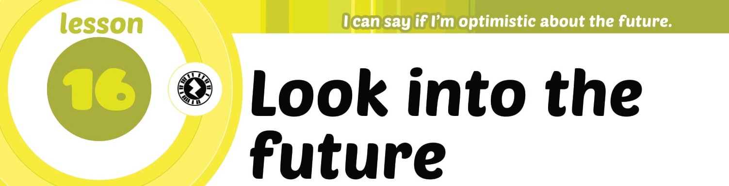

Slide 3
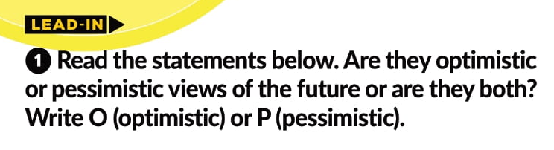
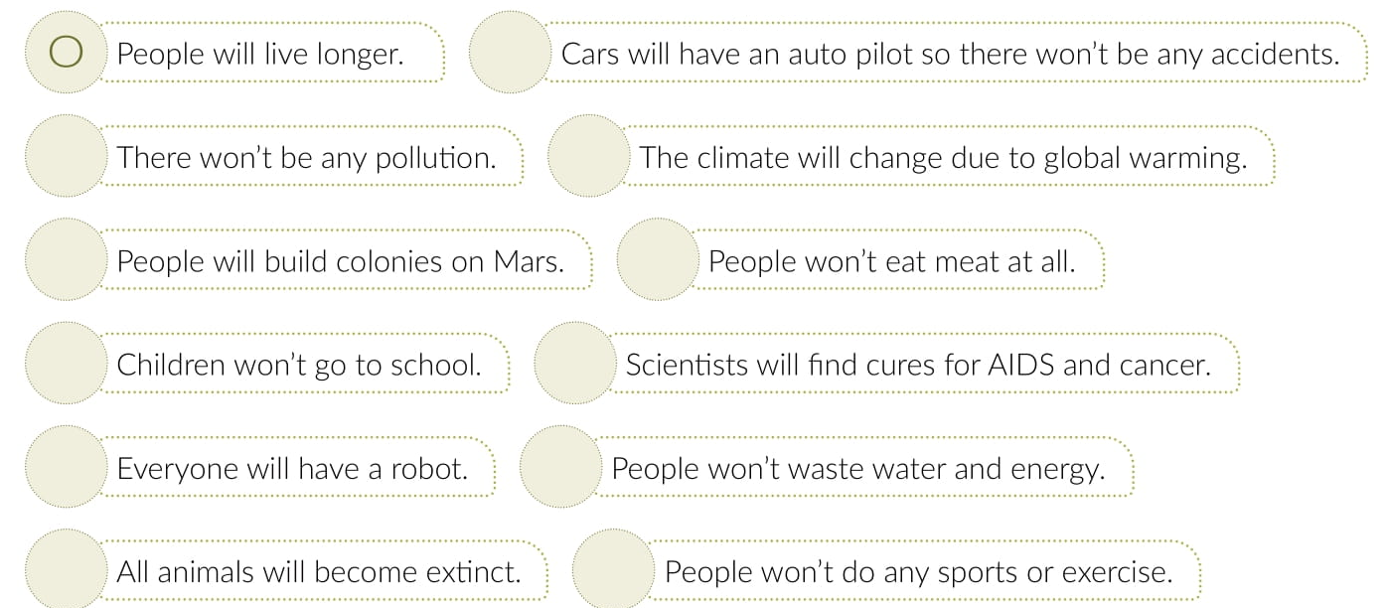
O
O
P
O
O
O P
O
O P
O
P
P

Slide 4


Slide 5

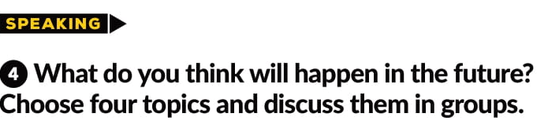
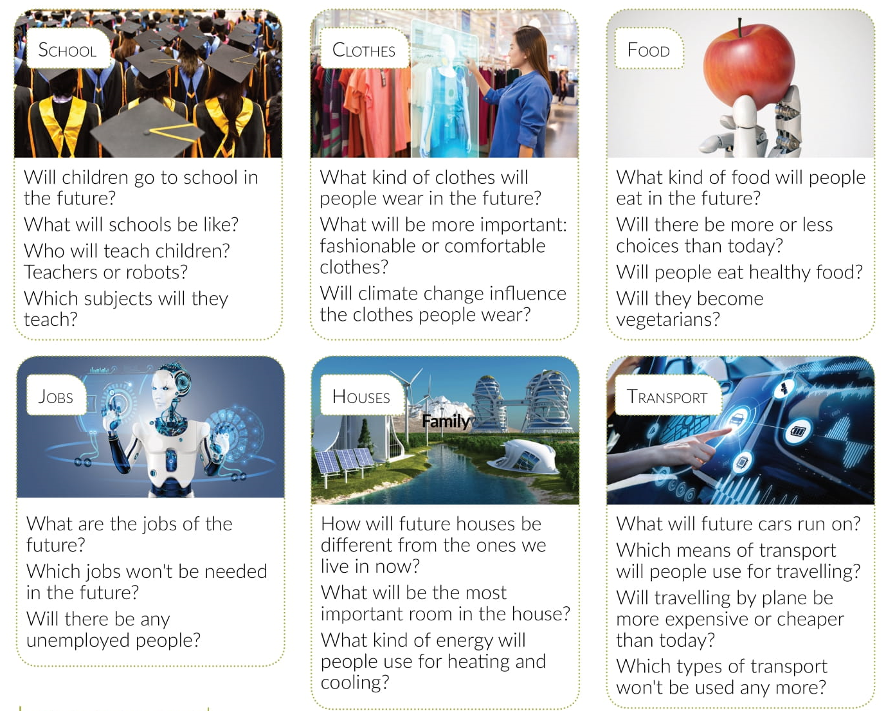


Slide 6
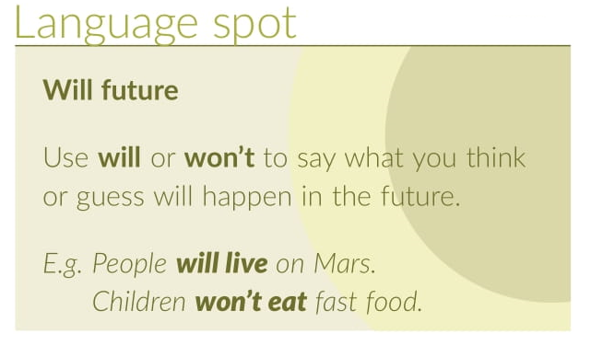
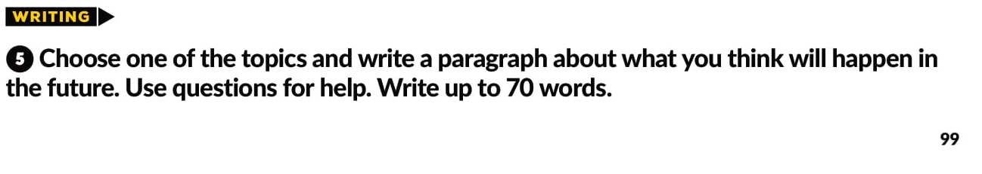

Slide 7
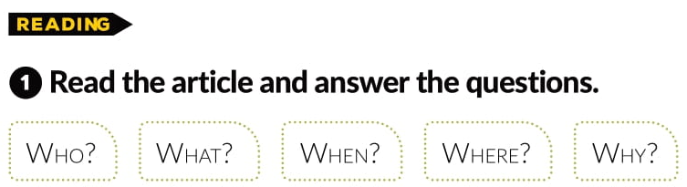

Slide 8
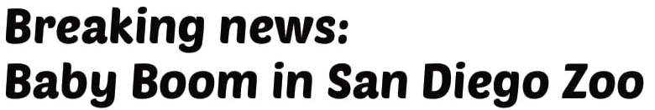
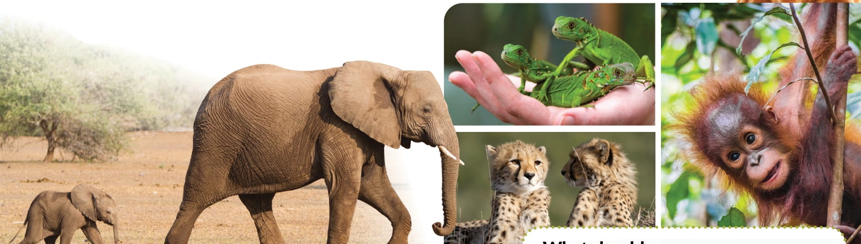
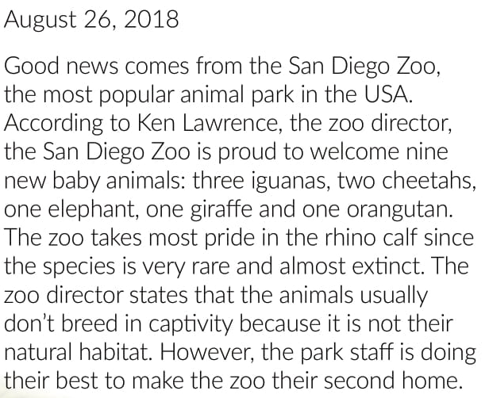
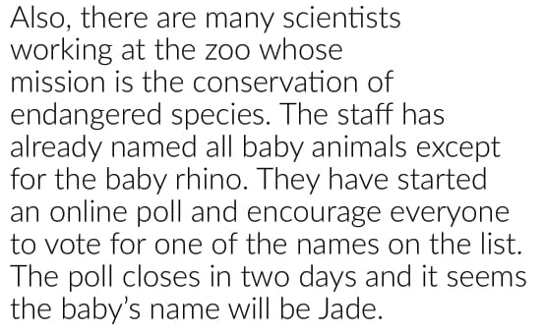

Slide 9
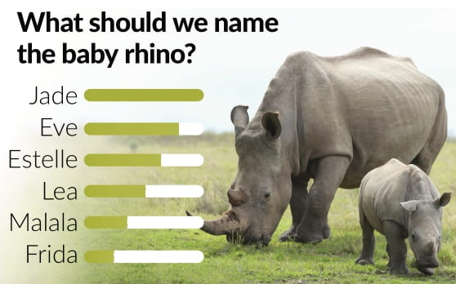
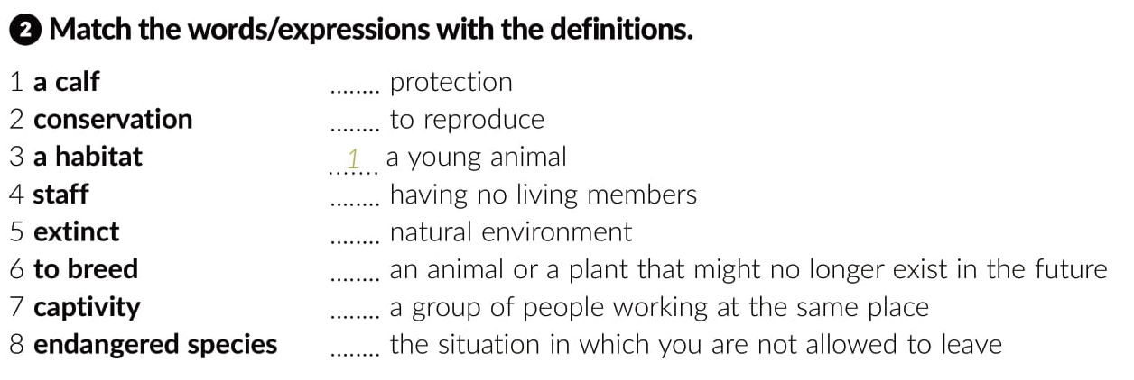
2
6
5
3
8
4
7

Slide 10


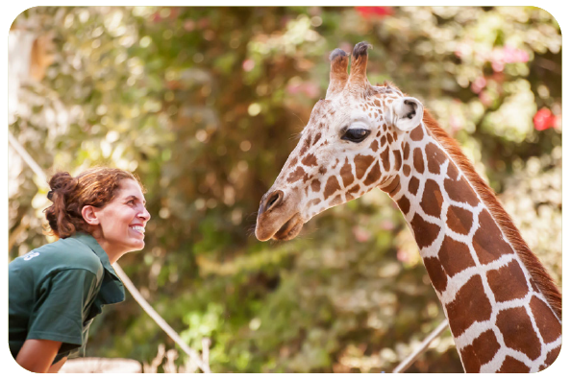
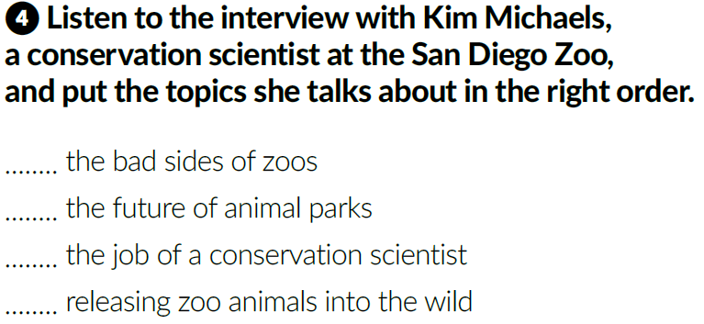
2
4
1
3
https://www.e-sfera.hr/dodatni-digitalni-sadrzaji/ba6cc9e7-67ce-4db1-9a12-41539cfa6eec/assets/audio/26_l16_-_kim_michaels.mp3

Slide 11
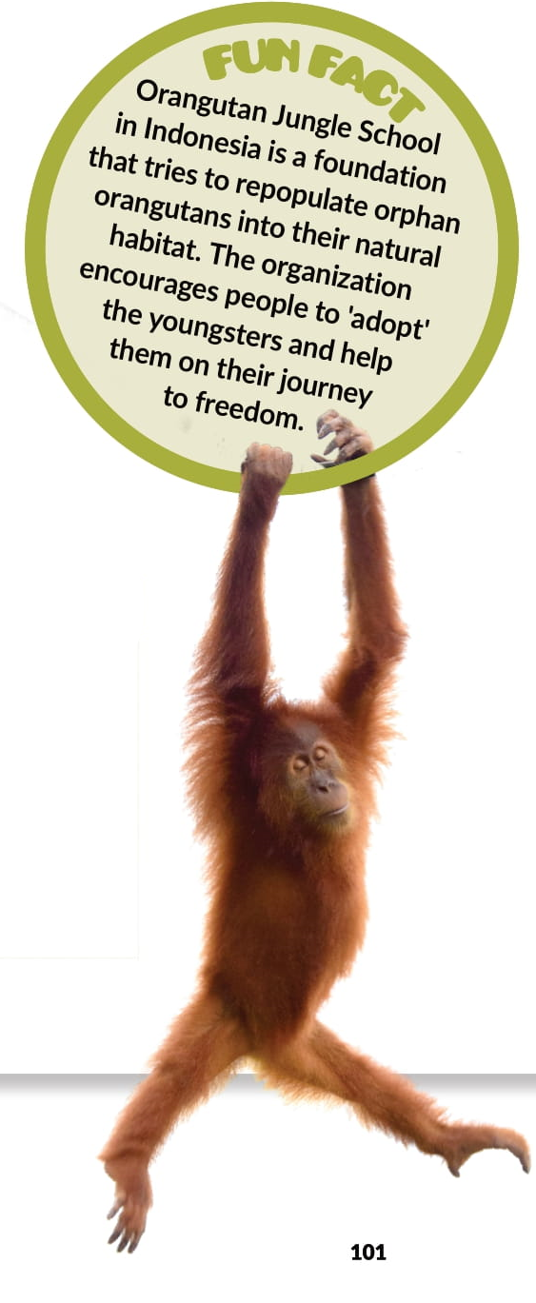
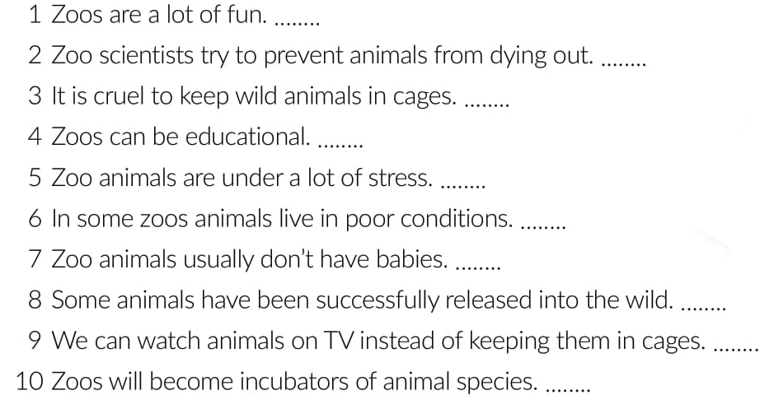


Slide 12
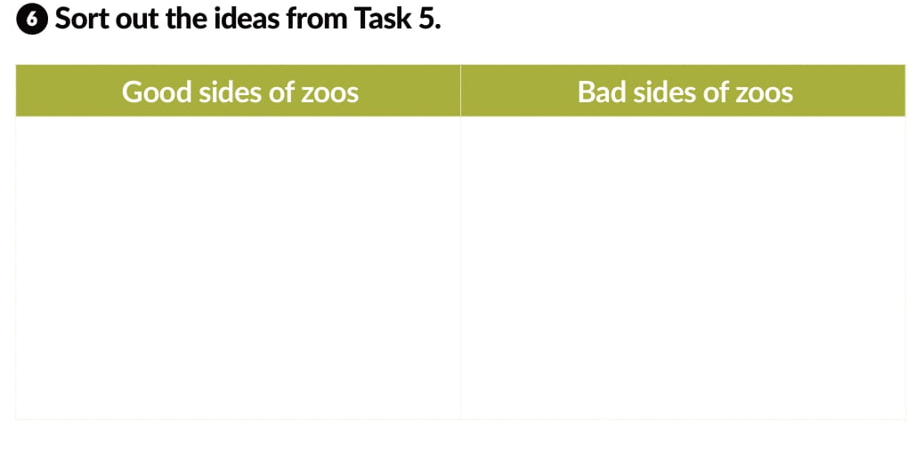
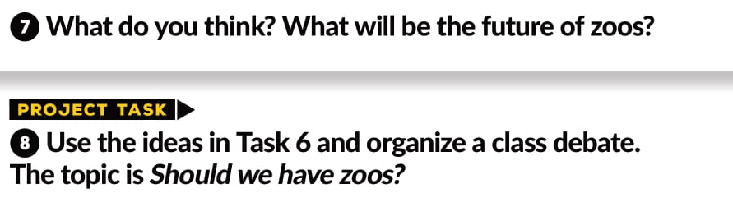
Zoo scientists prevent animals from dying out.
Animals are kept in cages, and this is cruel.
Zoos can be educational.
Zoo animals are under a lot of stress.
Some animals have been successfully released into the wild.
In some zoos animals live in poor conditions.
Zoo will become incubators of animal species.

Slide 13
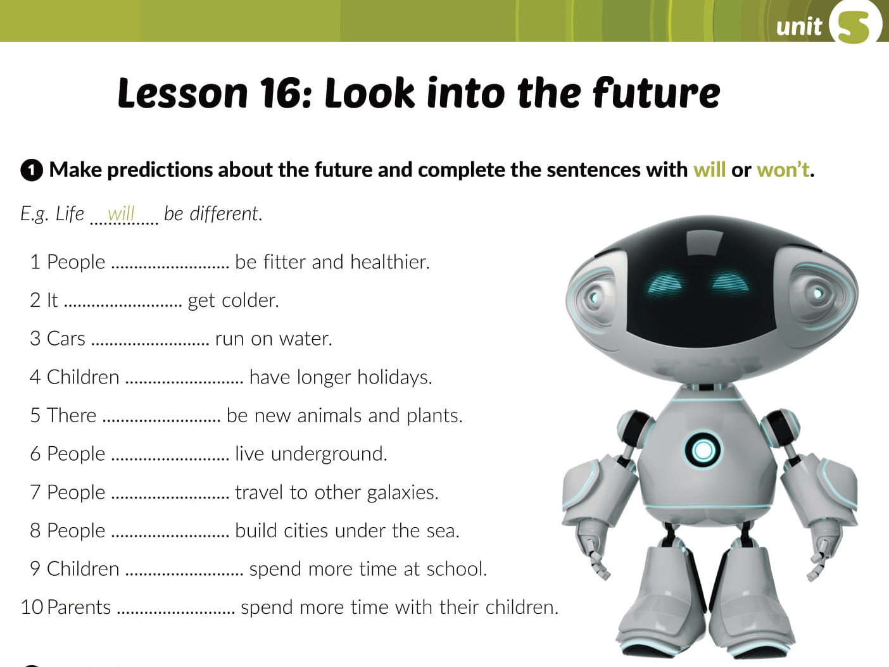
Workbook, page 71

Slide 14
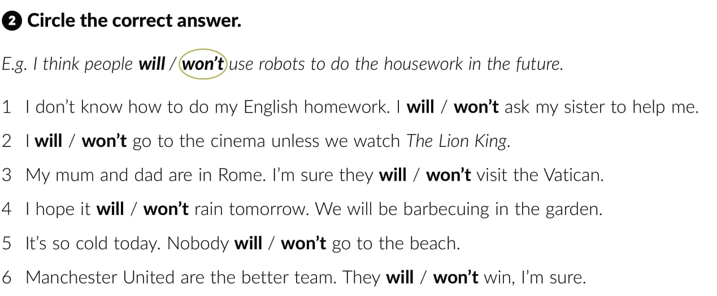

Slide 15
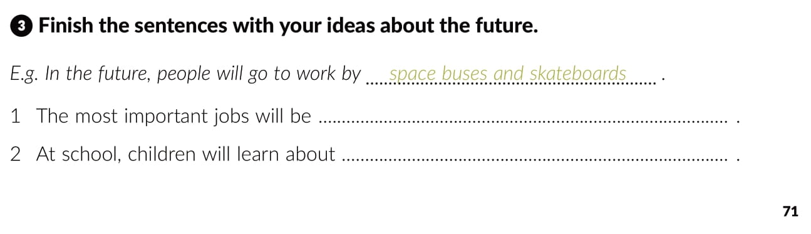
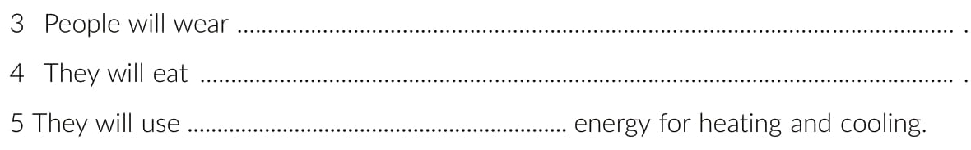

Slide 16
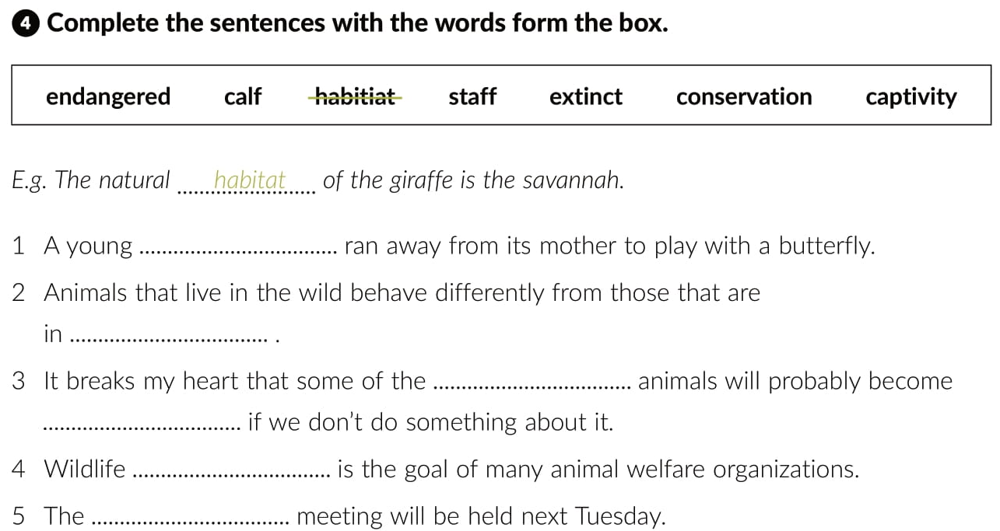
calf
captivity
endangered
extinct
conservation
staff

Slide 17
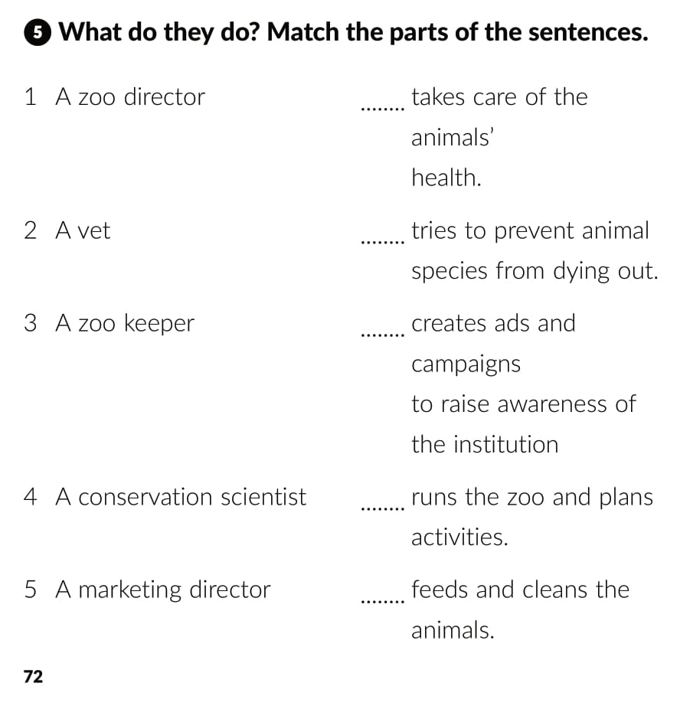
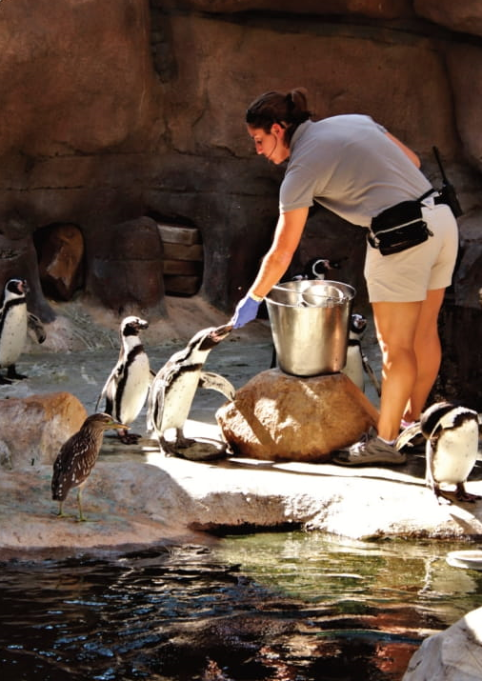
2
4
5
1
3

Slide 18
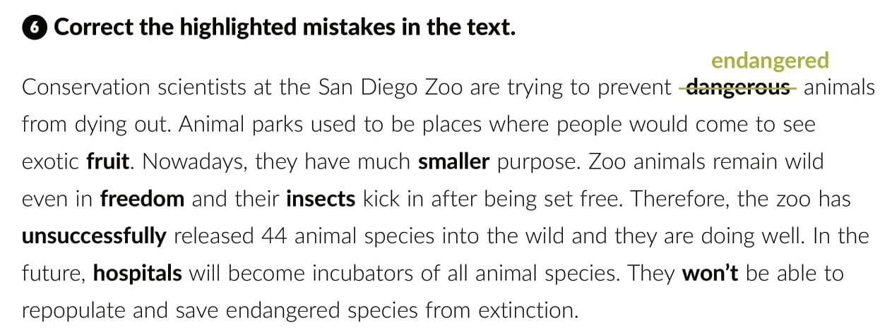
animals
greater
captivity
instincts
successfully
zoos
will

Slide 19
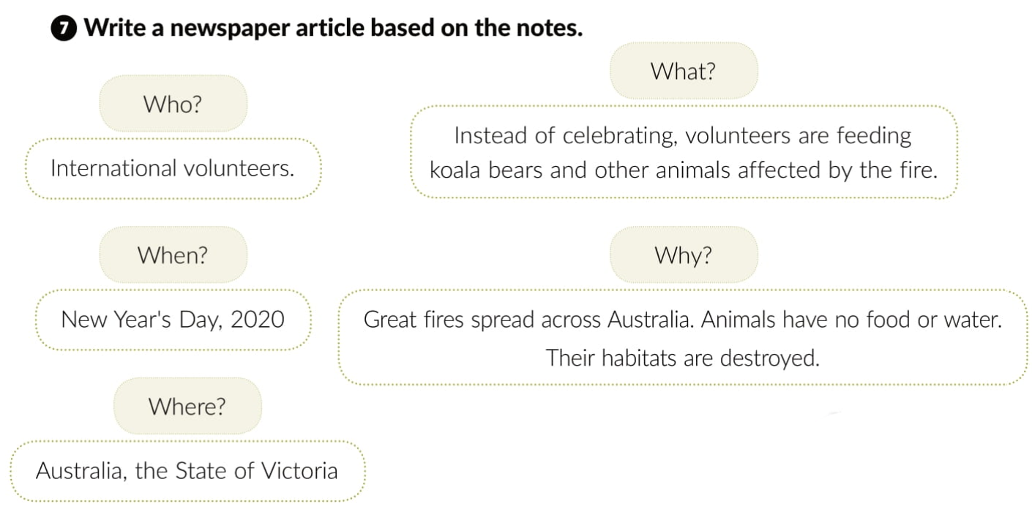
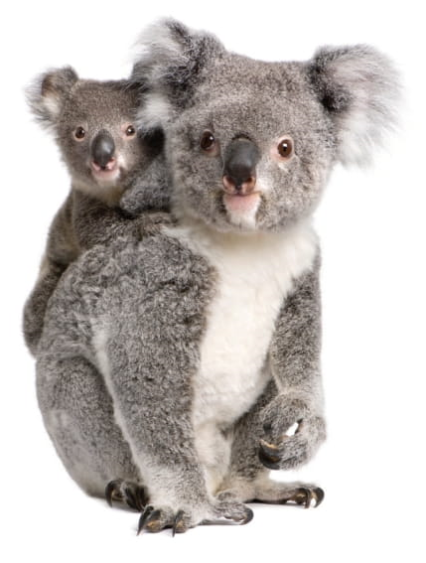
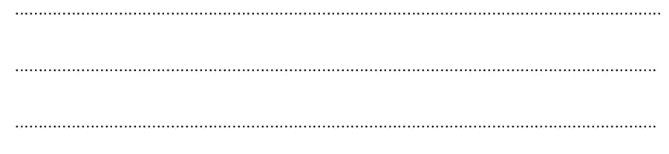

Slide 20
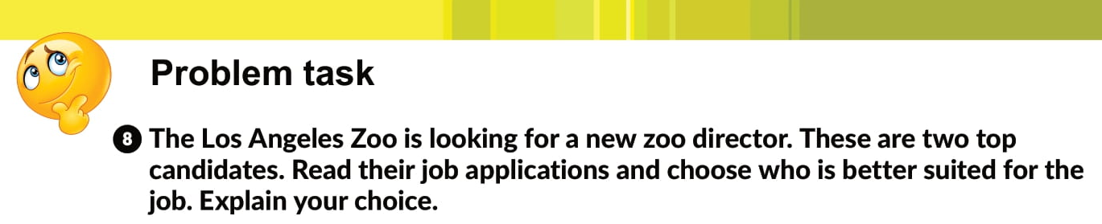

Slide 21
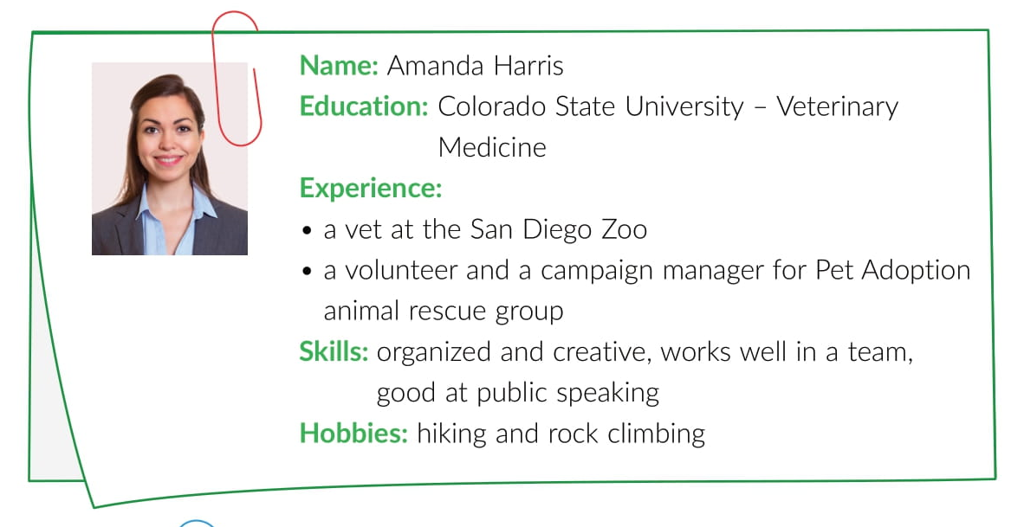

Slide 22
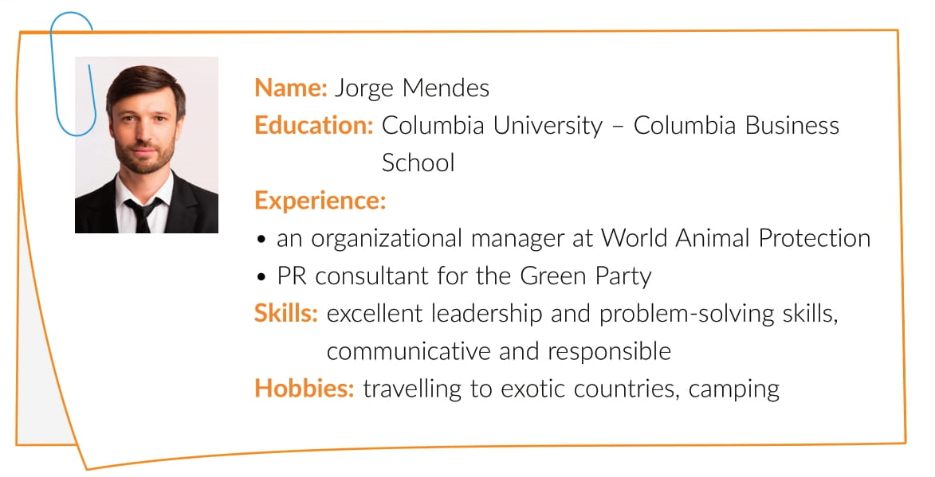

Slide 23
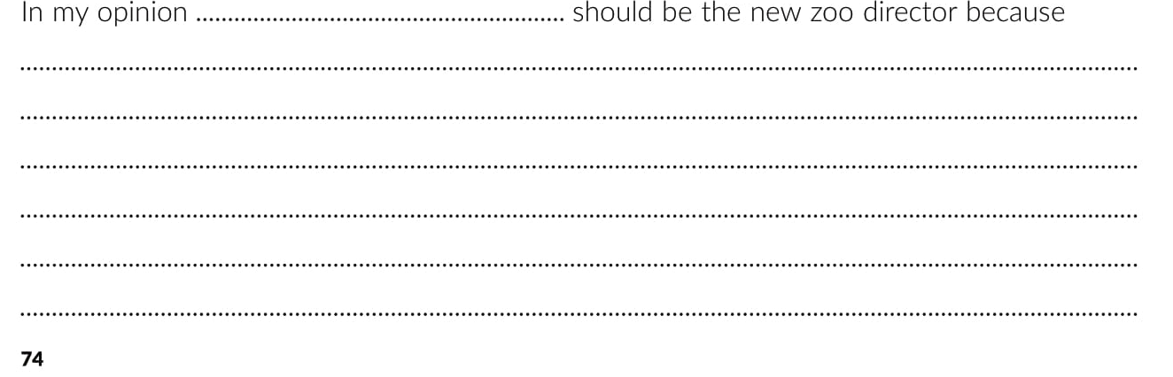

Slide 24

Otvori sljedeću poveznicu, te odaberi PLAY AND LEARN!
Lesson 16 Look into the future | Way to go 4 (e-sfera.hr)

